Slide 1

Capstone 1 Template
Restoring of the historical lost data of TractorTEK using Python, Excel, Jupyter and Real-Time data using MySQL
Presented by: Aziz Mohammad
March 11th, 2022

Slide 2
Agenda:
TractorTEK Website: Sales data entry
Sales Dashboard
Facts and Findings
Data output
Import data into MySQL form Excel file
Output sample data
Historical Data Transfer using Jupyter
Output sample data
Excel Dashboard
Insights: Data & Graph
Facts & Findings

Slide 3
website
Simple UI Screen (website) to capture real-time data using Python Flask

Slide 4
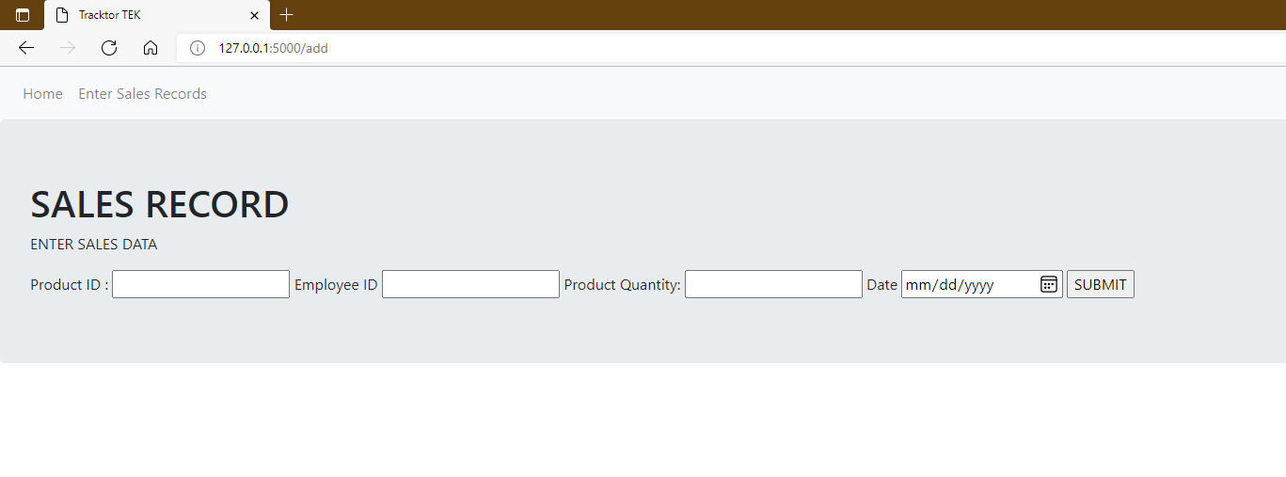
Website to Enter Sales Records
Items to capture:
Product ID
Employee ID
Product Quantity
Date

Slide 5
Using Pycharm
Grabbing data from website
Assigning data to sales object
Adding the object to MySQL

Slide 6
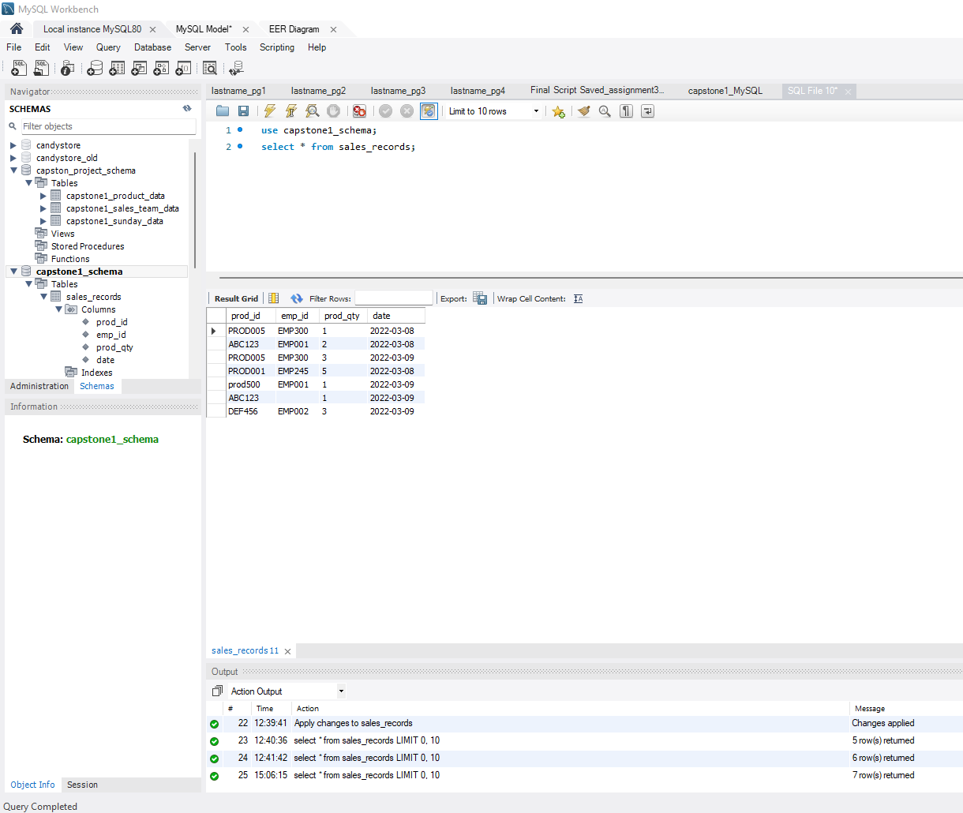
Sample Data in MySQL

Slide 7
Import historical data from Excel to MySQL
Import in MySQL from Excel historical data
Form:
Product Table
Sales Table
Sunday Table

Slide 8
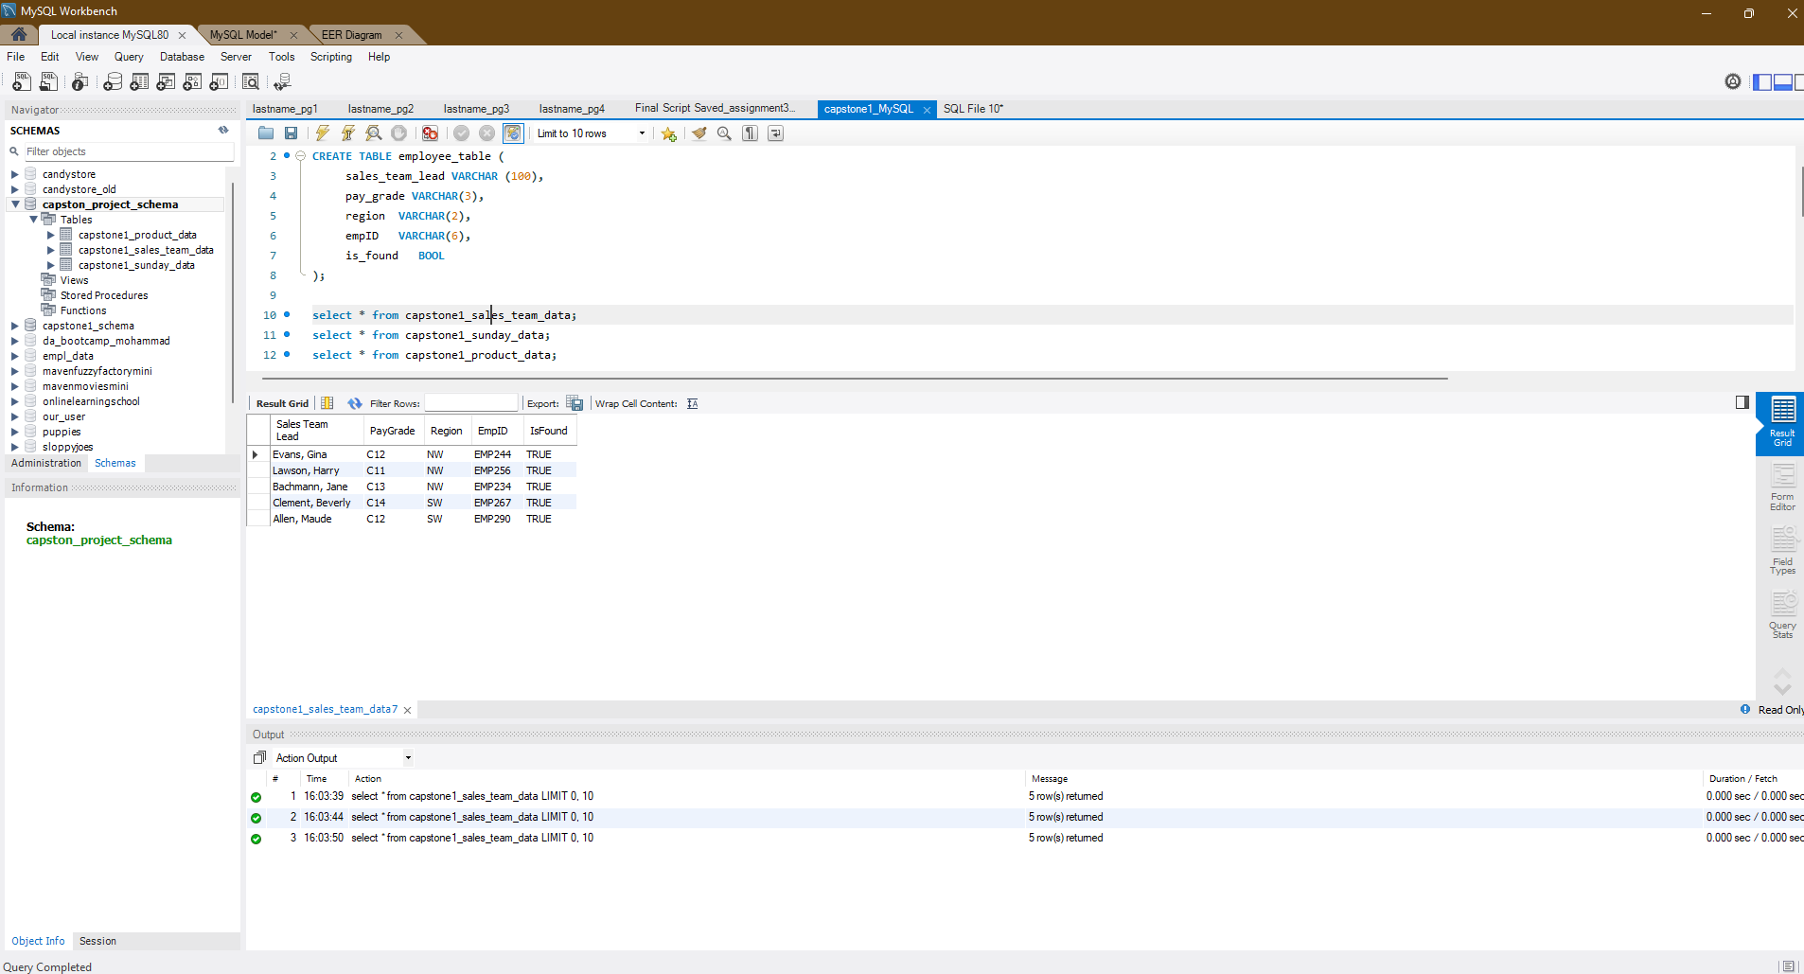
Sales Team data Sample form Excel to MySQL

Slide 9
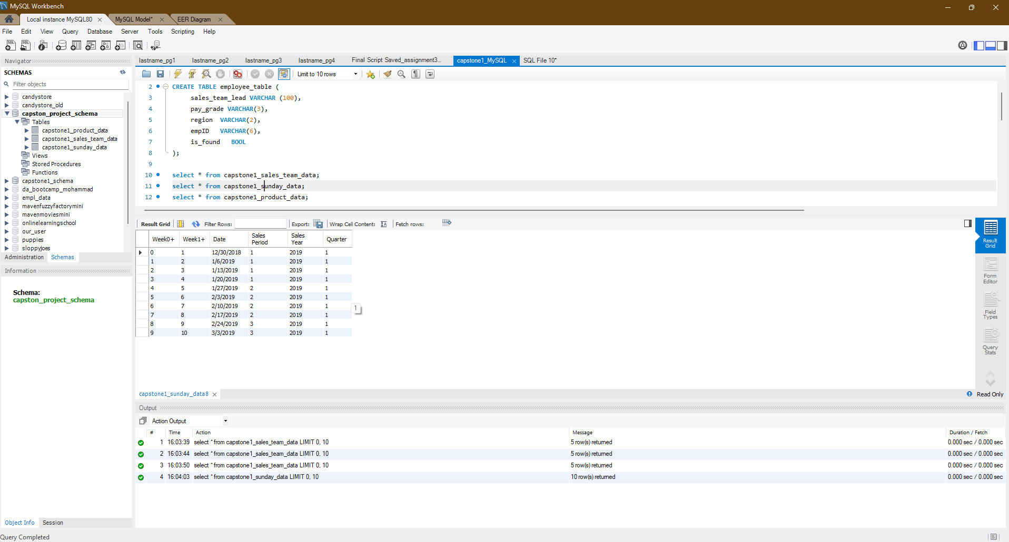
Sunday data sample from Excel to MySQL

Slide 10
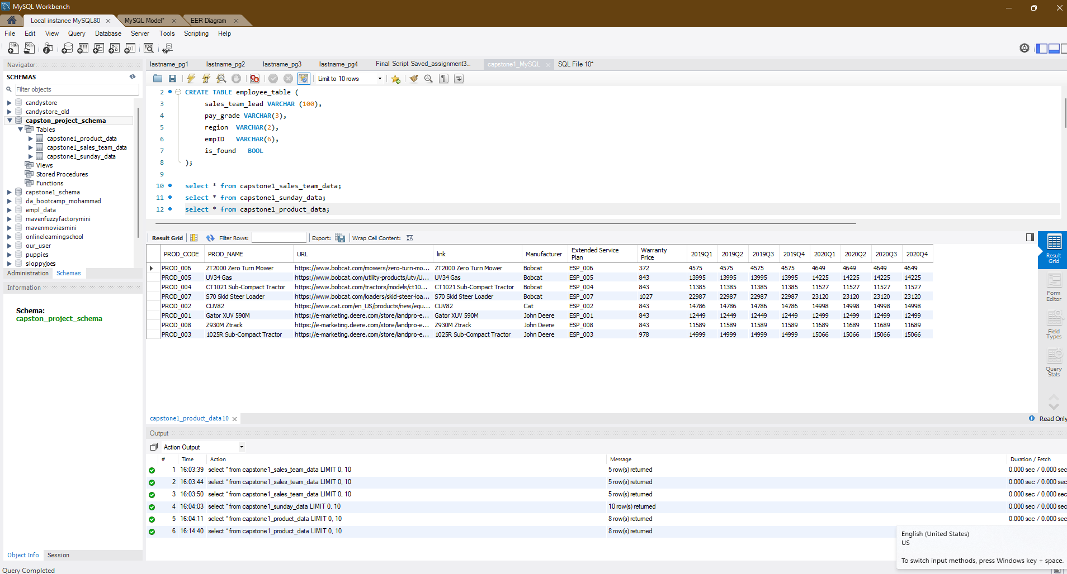
Product sample data from Excel to MySQL

Slide 11
Historical Excel data using Jupyter Notebook
Using Jupyter to retrieve Excel historical data:
Sales Team data
Sunday data
Product data
Join two table using concat

Slide 12
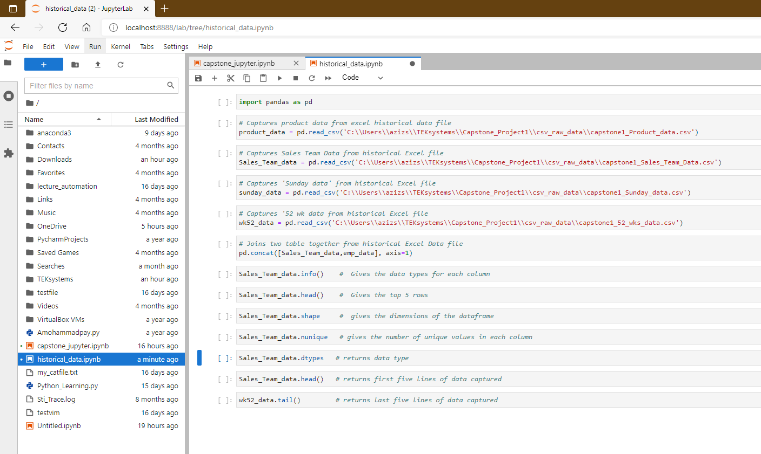
Sample Jupyter Code to retrieve data from Excel

Slide 13
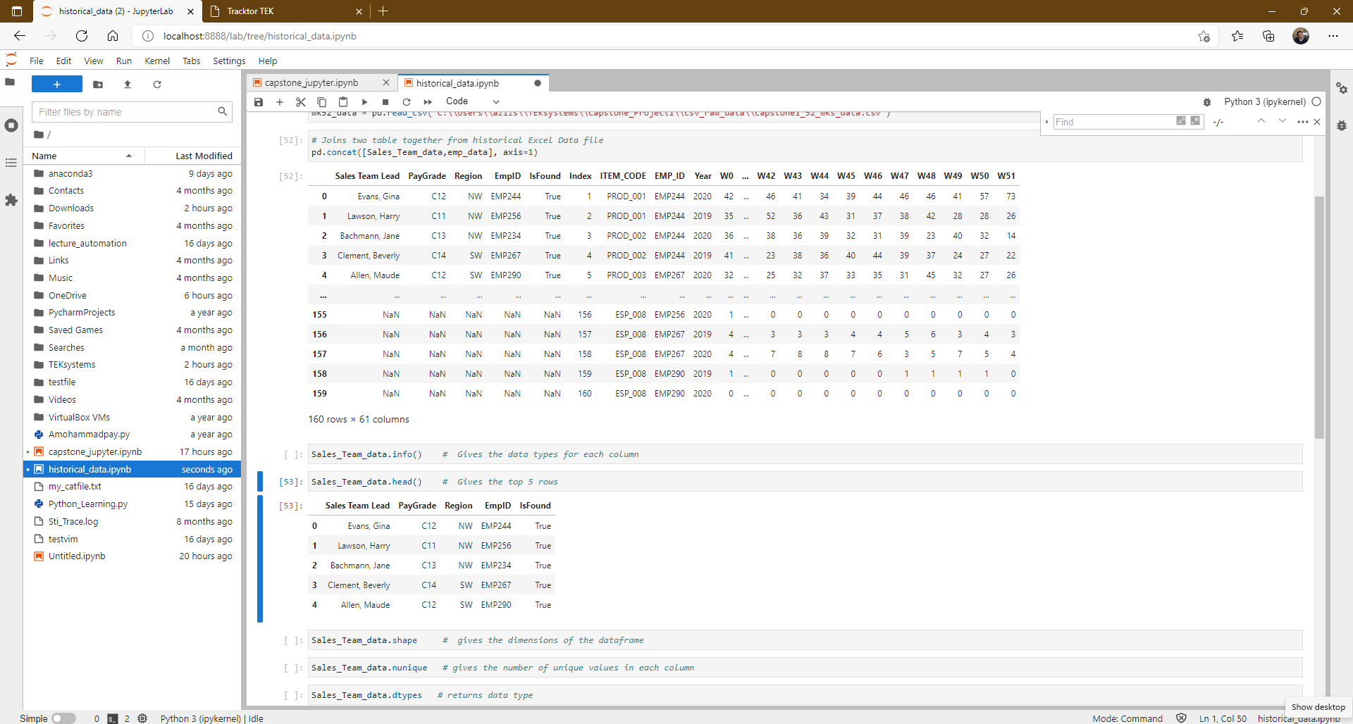
Jupyter sample output

Slide 14
Excel Dashboard
Data and graph for insight:
Sales Data by Region
Sales Data by Salesperson
Top Ranking Salesperson
Sales by Category

Slide 15
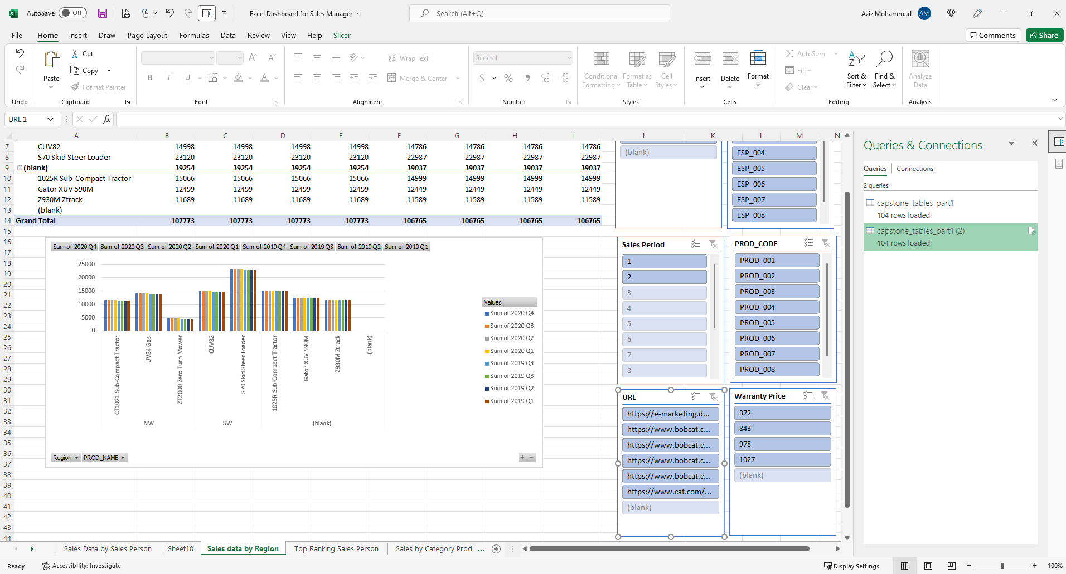
Sales Data by Region

Slide 16
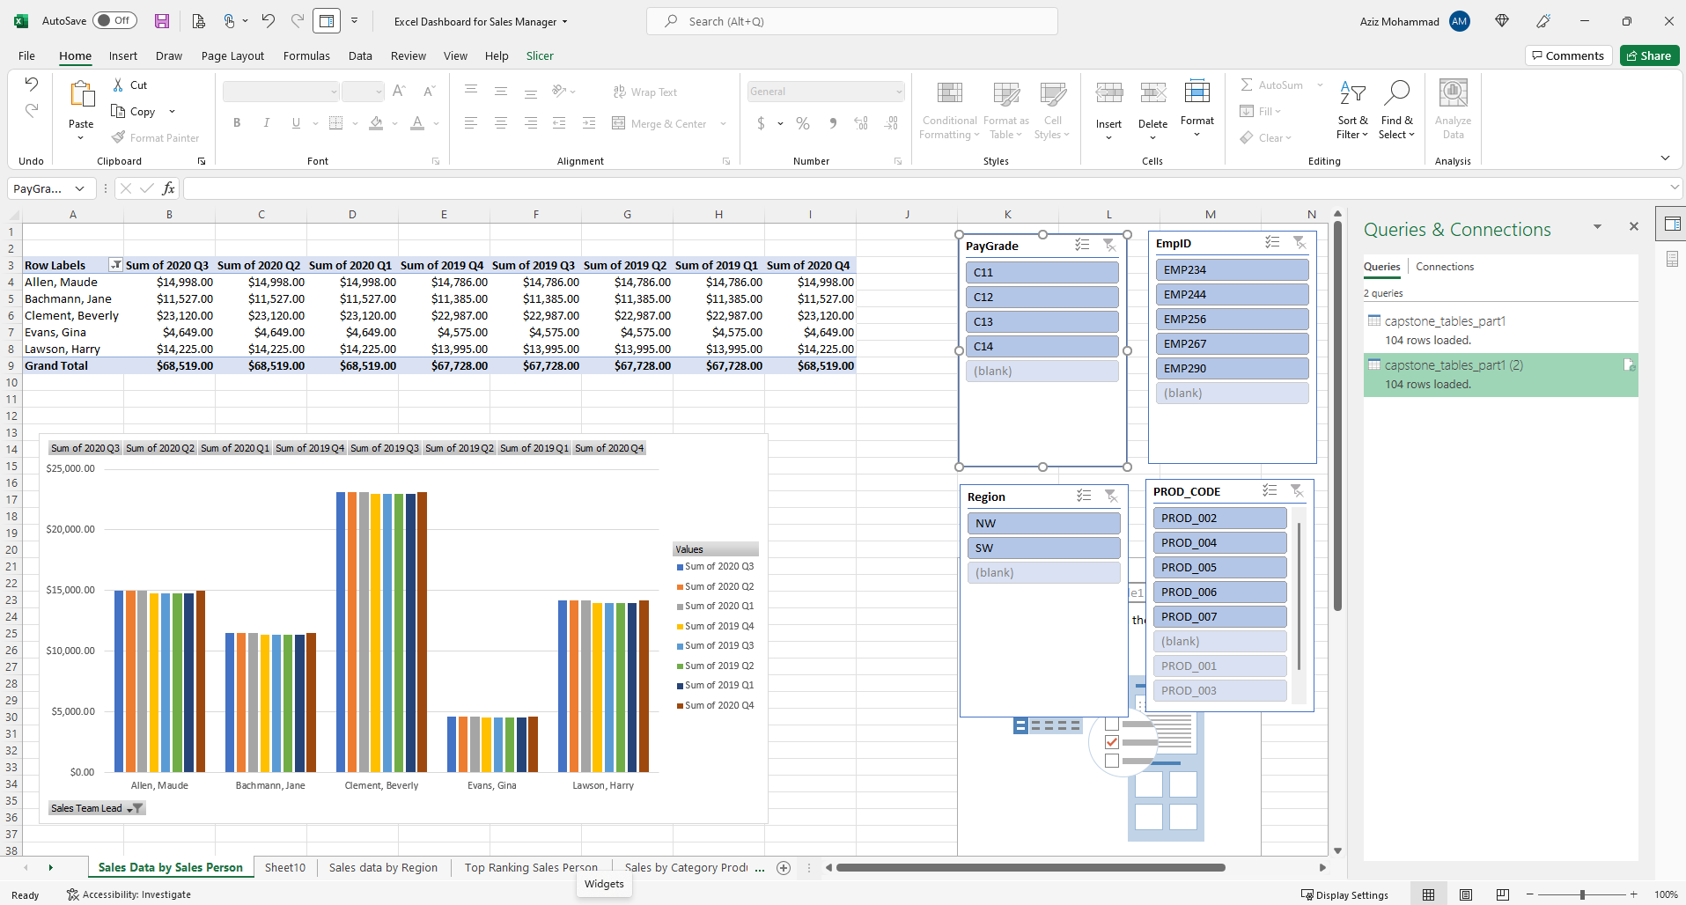
Sales Data by Salesperson

Slide 17
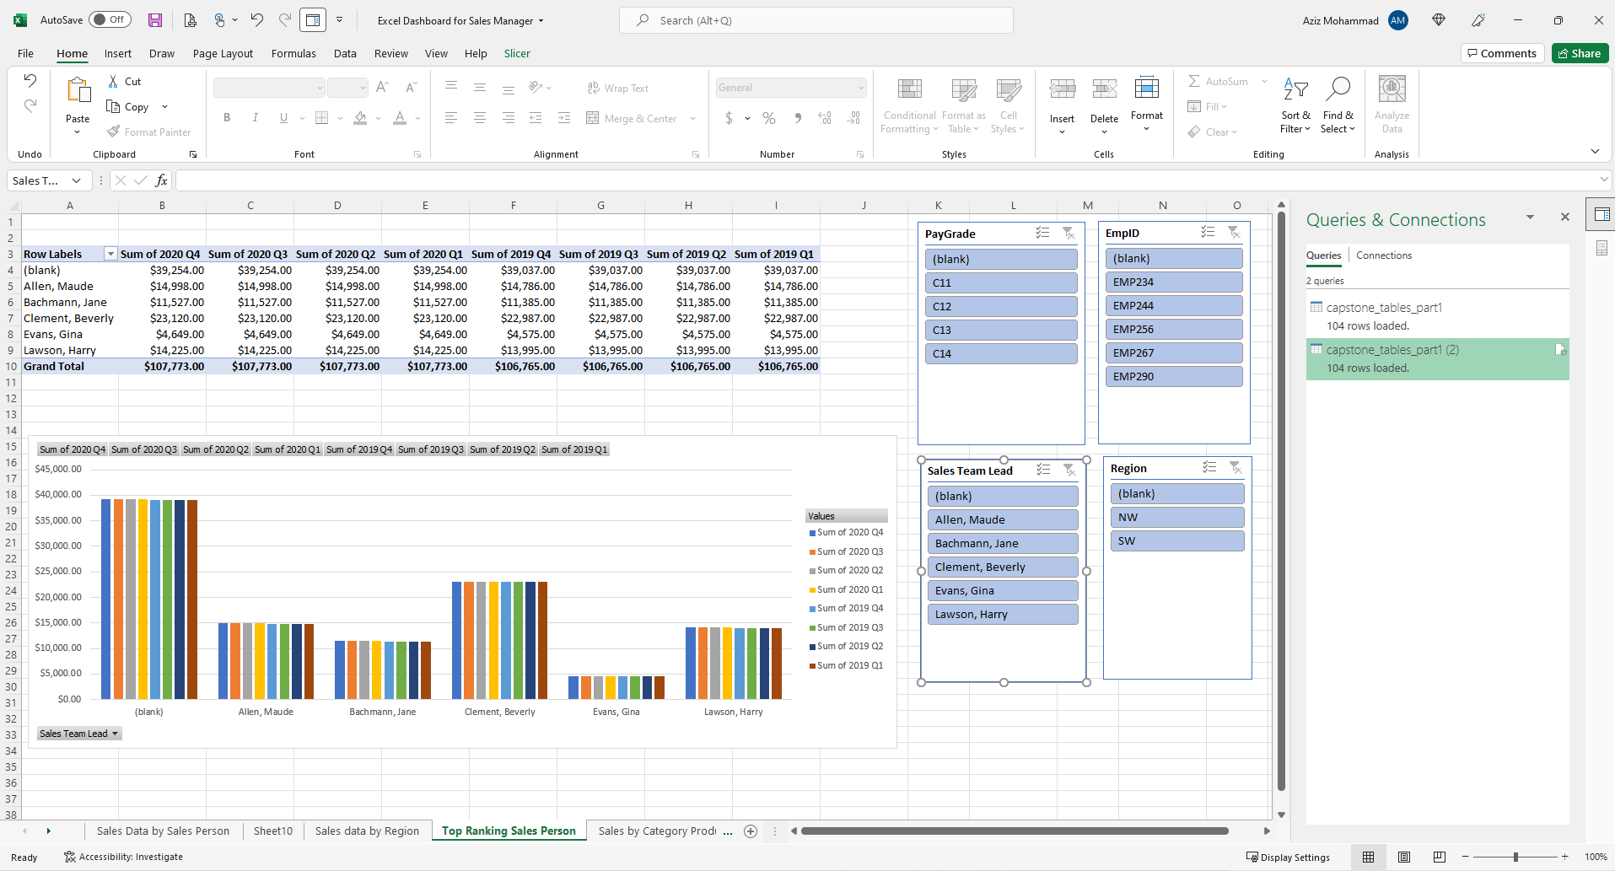
Top Ranking Salesperson

Slide 18
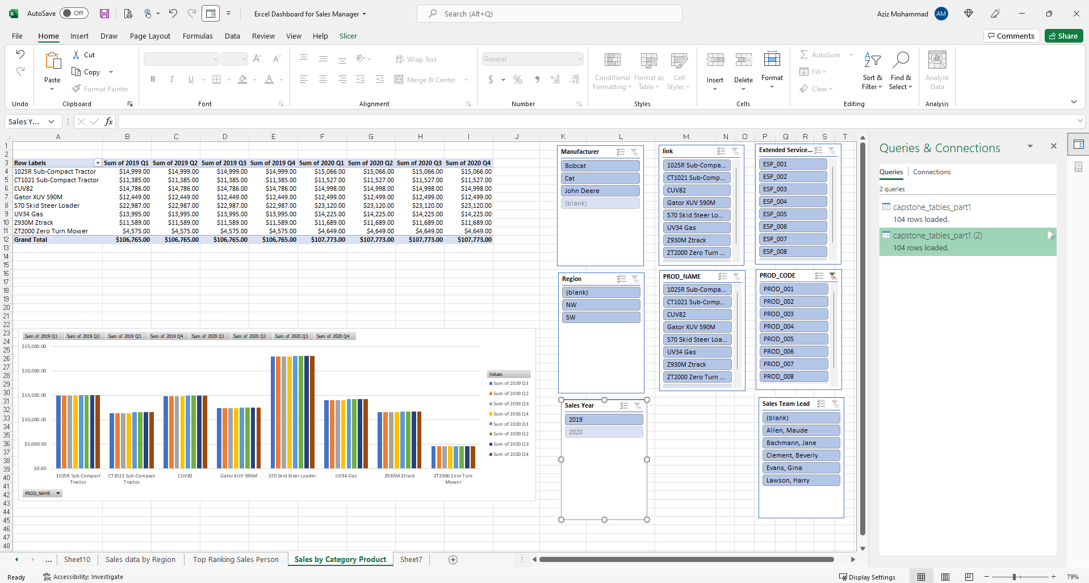
Sales by Category

Slide 19
Insights
Best Selling Product: S70 Skid Steer Loader
Top Selling Salesperson: Clement Beverly
Best Selling Region: Southwest
Best Selling Region by Salesperson: SW by Clement Beverly

Slide 20
Questions!

Slide 21
Divider Slide for Presentation use only
This Subtitle is Arial in Medium Blue

